Slide 1

O-TWO
Team Members
Ani Siva Rama Krishna, Chelluboyina – U01027636
Priyanka, Kamatham – U01036286
Sasi, Maddineni – U01016161
Surya Teja, Sunkavalli – U01032106
Target Markets: Patients Suffering from Covid-19 and other complications.
Value Propositions: No.8 in Periodic table but No.1 for your existence.

Slide 2
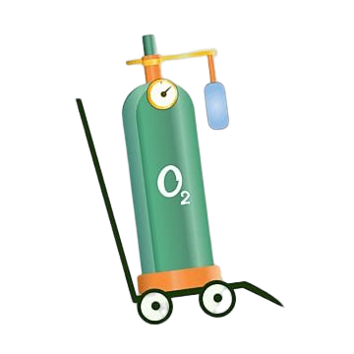

KEY WINNING FEATURES
If a user consistently orders oxygen three or more times in a span of ten days, he gets placed to the spam list.
Embedding of voice command & control sensors onto the application.
If ever, there is a shortage of oxygen tanks. The specific user gets notified when it’s available.

Slide 3

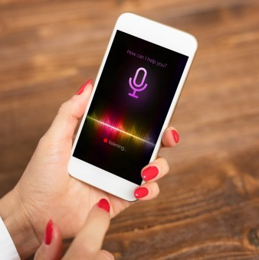

Capabilities
Help
Chatbots provide users with quick responses regarding the availability of oxygen.
Assist
The voice command & control feature will assist the visually impaired individuals have their information captured by the app.

Slide 4
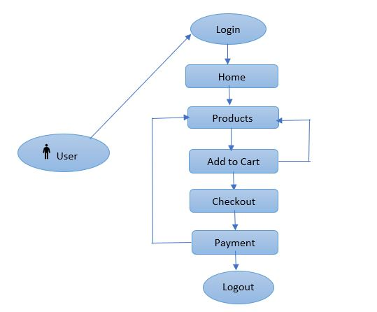
WORKFLOW

Slide 5
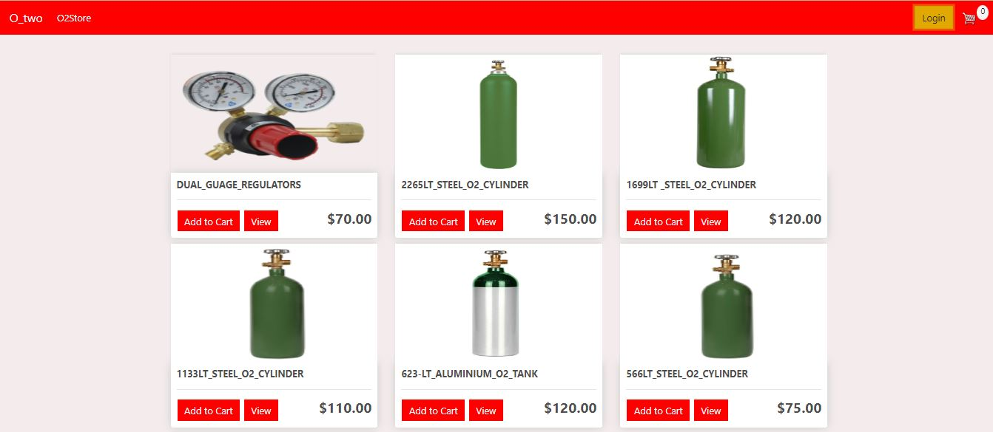
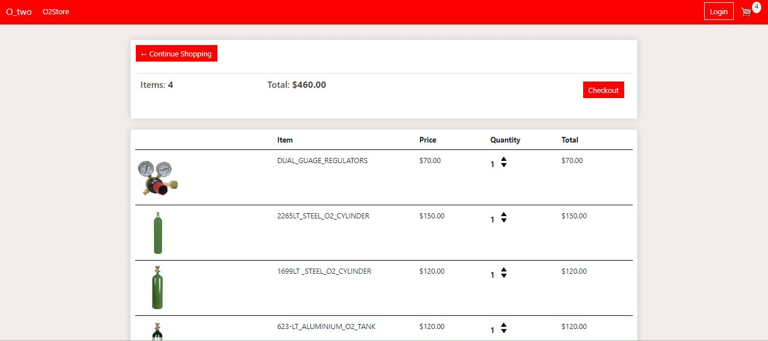
Front end UI for end user

Slide 6

Justification
This website can be used by all groups of people (any patients and hospitals) which leads the higher rate of patient survival.
Considering how vital oxygen is to humans, O₂ should be available for all species.
The website shall be able to notify the users when the item is in-stock.
An all-time available connectivity, therefore, the website can be found and used at any time.

Slide 7
Conclusion & Plan for implementation
This section outlined some of the building block features of the website. We have also elaborated on the website capabilities and justified why this webapp is important.
Going forward, we shall implement the development of this website on Python.
We still need to create the order page, login page, chatbots, and key winning features.
We shall also do a pilot testing for the prototype and the complete developing the website.

Slide 8


